Slide 1
Artificial Intelligence
Planning

Slide 2
Outline
The Planning problem
Planning with State-space search
Partial-order planning
Planning graphs

Slide 3
Planning problem
Classical planning environment: fully observable, deterministic, finite, static and discrete.
Find a sequence of actions that achieves a given goal when executed from a given initial world state. That is, given
a set of action descriptions (defining the possible primitive actions by the agent),
an initial state description, and
a goal state description or predicate,
compute a plan, which is
a sequence of action instances, such that executing them in the initial state will change the world to a state satisfying the goal-state description.
Goals are usually specified as a conjunction of subgoals to be achieved

Slide 4
Planning vs. problem solving
Planning and problem solving methods can often solve the same sorts of problems
Planning is more powerful because of the representations and methods used
States, goals, and actions are decomposed into sets of sentences (usually in first-order logic)
Search often proceeds through plan space rather than state space (though first we will talk about state-space planners)
Subgoals can be planned independently, reducing the complexity of the planning problem

Slide 5
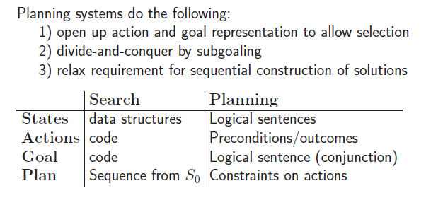
Planning vs. problem solving

Slide 6
Goal of Planning
Choose actions to achieve a certain goal
But isn’t it exactly the same goal as for problem solving?
Some difficulties with problem solving:
The successor function is a black box: it must be “applied” to a state to know which actions are possible in that state and what are the effects of each one

Slide 7
Have(Milk)
Suppose that the goal is HAVE(MILK).
From some initial state where HAVE(MILK) is not satisfied, the successor function must be repeatedly applied to eventually generate a state where HAVE(MILK) is satisfied.
An explicit representation of the possible actions and their effects would help the problem solver select the relevant actions
Otherwise, in the real world an agent would be overwhelmed by irrelevant actions

Slide 8
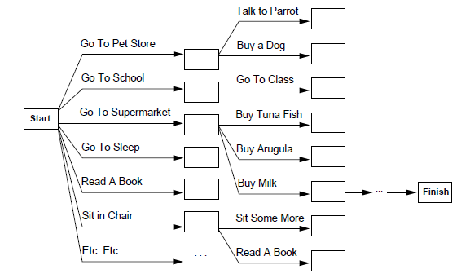
Have(Milk)

Slide 9
Planning vs Problem Solving
Another difficulty with problem solving:
The goal test is another black-box function, states are domain-specific data structures, and heuristics must be supplied for each new problem
Suppose that the goal is HAVE(MILK)∧HAVE(BOOK)
Without an explicit representation of the goal, the problem solver cannot know that a state where HAVE(MILK) is already achieved is more promising than a state where neither HAVE(MILK) nor HAVE(BOOK) is achieved

Slide 10
Planning vs Problem Solving
A third difficulty with problem solving:
The goal may consist of several nearly independent subgoals, but there is no way for the problem solver to know it
HAVE(MILK) and HAVE(BOOK) may be achieved by two nearly independent sequences of actions

Slide 11
Applications of Planning
Military operations
Construction tasks
Machining tasks
Mechanical assembly
Design of experiments in genetics
Command sequences for satellite
Most applied systems use extended
representation languages, nonlinear
planning techniques, and domain-specific heuristics

Slide 12
Representations in Planning
Planning opens up the black-boxes by using logic to represent:
Actions
States
Goals
Problem solving
Logic representation
Planning

Slide 13
Planning language
What is a good language?
Must represent
States
Goals
Action.
Must be
Expressive enough to describe a wide variety of problems.
Restrictive enough to allow efficient algorithms to operate.

Slide 14
Languages for Planning Problems
STRIPS
Stanford Research Institute Problem Solver
Historically important
ADL
Action Description Languages
Relaxed some of the restrictions that made STRIPS inadequate for real-world problems
PDDL
Planning Domain Definition Language
Revised & enhanced for the needs of the International Planning Competition
Currently version 3.1
Includes STRIPS and ADL

Slide 15
Planning Domain Definition Language
Components:
Objects: things we are interested in
Predicates: properties of objects, true or false
Initial state: state of the world we start in
Goal specification: state we want to end up in
Actions: ways we can change state
Format
domain file: predicates and actions
problem file: objects, initial state, goal

Slide 16
STRIPS General language features
Representation of states
Decompose world in logical conditions and represent state as conjunction of positive literals.
Propositional literals: Poor ∧ Unknown
FO-literals (grounded and function-free):
at(plane1, phl) ∧ at(plane2, bwi)
does not allow
at(X,Y), (not grounded)
at(father(fred),bwi), (function)
¬at(plane1, phl. (negative literal)

Slide 17
STRIPS Cont
Closed world assumption
Representation of goals
Partially specified state and represented as a conjunction of positive ground literals
A goal is satisfied if the state contains all literals in goal.
e.g.: at(paula, phl) ∧ at(john,bwi) satisfies the goal at(paula, phl)

Slide 18
General language features
Representations of actions
Action = PRECOND + EFFECT
Action(Fly(p,from, to),
PRECOND: At(p,from) ∧ Plane(p) ∧ Airport(from) ∧ Airport(to)
EFFECT: ¬AT(p,from) ∧ At(p,to))
= action schema (p, from, to need to be instantiated)
Action name and parameter list
Precondition (conj. of function-free literals)
Effect (conj of function-free literals and P is True and not P is false)
May split Add-list and delete-list in Effect

Slide 19
Example
Paula flies from Philadelphia to Baltimore
Action(Fly(p,from,to)
PRECOND: At(p,from) ∧ Plane(p) ∧ Airport(from) ∧ Airport(to)
EFFECT: ¬At(p,from) ∧ At(p,to))
We begin with
At(paula,phl) ∧ Plane(phl) ∧ Airport(phl) ∧ Airport(bwi)
We take the action
Fly(paula, phl, bwi)
We end with
←At(paula,phl) ∧ At(paula, bwi)
Note that we haven’t said anything in the effect about what happened to the plane. Do we care?

Slide 20
Language semantics?
How do actions affect states?
An action is applicable in any state that satisfies the precondition.
For FO action schema applicability involves a substitution θ for the variables in the PRECOND.
At(P1,JFK) ∧ At(P2,SFO) ∧ Plane(P1) ∧ Plane(P2) ∧ Airport(JFK) ∧ Airport(SFO)
Satisfies : At(p,from) ∧ Plane(p) ∧ Airport(from) ∧ Airport(to)
With θ ={p/P1,from/JFK,to/SFO}
Thus the action is applicable.

Slide 21
Language semantics?
The result of executing action a in state s is the state s’
s’ is same as s except
Any positive literal P in the effect of a is added to s’
Any negative literal ¬P is removed from s’
EFFECT: ¬AT(p,from) ∧ At(p,to):
At(P1,SFO) ∧ At(P2,SFO) ∧ Plane(P1) ∧ Plane(P2) ∧ Airport(JFK) ∧ Airport(SFO)
STRIPS assumption: (avoids representational frame problem)
every literal NOT in the effect remains unchanged

Slide 22
Blocks world
The blocks world is a micro-world that consists of a table, a set of blocks and a robot hand.
Some domain constraints:
Only one block can be on another block
Any number of blocks can be on the table
The hand can only hold one block
Typical representation:
ontable(a)
ontable(c)
on(b,a)
handempty
clear(b)
clear(c)
B
A
C
TABLE

Slide 23
State Representation
C
A
B
TABLE
Conjunction of propositions:
BLOCK(A), BLOCK(B), BLOCK(C),
ON(A,TABLE), ON(B,TABLE), ON(C,A), CLEAR(B), CLEAR(C), HANDEMPTY

Slide 24
Goal Representation
C
B
A
Conjunction of propositions:
ON(A,TABLE), ON(B,A), ON(C,B)
The goal G is achieved in a state S if all the propositions in G are also in S

Slide 25
Action Representation
Action(Unstack(x,y)
P: HANDEMPTY, BLOCK(x), BLOCK(y), CLEAR(x), ON(x,y)
E: ¬HANDEMPTY, ¬CLEAR(x), HOLDING(x), ¬ ON(x,y), CLEAR(y)
Action(Stack(x,y)
P: HOLDING(x), BLOCK(x), BLOCK(y), CLEAR(y)
E: ON(x,y), ¬CLEAR(y), ¬HOLDING(x), CLEAR(x), HANDEMPTY

Slide 26
Actions
Action(Pickup(x)
P: HANDEMPTY, BLOCK(x), CLEAR(x), ON(x,TABLE)
E: ¬HANDEMPTY, ¬CLEAR(x), HOLDING(x), ¬ON(x,TABLE)
Action(PutDown(x)
P: HOLDING(x)
E: ON(x,TABLE), ¬HOLDING(x), CLEAR(x), HANDEMPTY

Slide 27
Example
BLOCK(A), BLOCK(B), BLOCK(C),
ON(A,TABLE), ON(B,TABLE), ON(C,A), CLEAR(B), CLEAR(C), HANDEMPTY
C
A
B
Unstack(C,A)
P = HANDEMPTY, BLOCK(C), BLOCK(A), CLEAR(C), ON(C,A)
E = ¬HANDEMPTY, ¬CLEAR(C), HOLDING(C), ¬ ON(C,A), CLEAR(A)

Slide 28
Example
C
BLOCK(A), BLOCK(B), BLOCK(C),
ON(A,TABLE), ON(B,TABLE), ON(C,A), CLEAR(B), CLEAR(C), HANDEMPTY,
HOLDING(C), CLEAR(A)
A
B
Unstack(C,A)
P = HANDEMPTY, BLOCK(C), BLOCK(A), CLEAR(C), ON(C,A)
E = ¬HANDEMPTY, ¬CLEAR(C), HOLDING(C), ¬ ON(C,A), CLEAR(A)

Slide 29
Example: Spare tire problem
Init(At(Flat, Axle) ∧ At(Spare,trunk))
Goal(At(Spare,Axle))
Action(Remove(Spare,Trunk)
PRECOND: At(Spare,Trunk)
EFFECT: ¬At(Spare,Trunk) ∧ At(Spare,Ground))
Action(Remove(Flat,Axle)
PRECOND: At(Flat,Axle)
EFFECT: ¬At(Flat,Axle) ∧ At(Flat,Ground))
Action(PutOn(Spare,Axle)
PRECOND: At(Spare,Groundp) ∧¬At(Flat,Axle)
EFFECT: At(Spare,Axle) ∧ ¬At(Spare,Ground))
Action(LeaveOvernight
PRECOND:
EFFECT: ¬ At(Spare,Ground) ∧ ¬ At(Spare,Axle) ∧ ¬ At(Spare,trunk) ∧ ¬ At(Flat,Ground) ∧ ¬ At(Flat,Axle) )
This example is ADL: negative literal in pre-condition

Slide 30
State-Space Search
Search the space of states
Initial state, goal test, step cost, etc.
Actions are the transitions between state
Actions are invertible (why?)
Move forward from the initial state: Forward State-Space Search or Progression Planning
Move backward from goal state: Backward State-Space Search or Regression Planning

Slide 31
State-Space Formulation
Formulation as state-space search problem:
Initial state = initial state of the planning problem
Literals not appearing are false
Actions = those whose preconditions are satisfied
Add positive effects, delete negative
Goal test = does the state satisfy the goal?
Step cost = each action costs 1
Solution is a sequence of actions.

Slide 32
SRIPS in State-Space Search
STRIPS representation makes it easy to focus on ‘relevant’ propositions and
Work backward from goal (using Effects)
Work forward from initial state (using Preconditions)
Facilitating bidirectional search

Slide 33
Progression Algorithm
No functions, so the number of states is finite … any graph search that is complete is a complete planning algorithm.
E.g. A*
Inefficient:
(1) irrelevant action problem
(2) good heuristic required for efficient search

Slide 34
Relevant Action
An action is relevant
In Progression planning when its preconditions match a subset of the current state
In Regression planning, when its effects match a subset of the current goal state

Slide 35
Forward Planning
Pickup(B)
B
C
C
C
B
A
B
A
A
Unstack(C,A))
Forward planning searches a state space
C
C
C
B
A
B
A
B
A
In general, many actions are applicable to a state → huge branching factor
B
B
A
B
C
A
C
A
C

Slide 36
Regression algorithm
How to determine predecessors?
What are the states from which applying a given action leads to the goal?
Actions must not undo desired literals (consistent)
Main advantage: only relevant actions are considered.
Often much lower branching factor than forward search.

Slide 37
Consistent Action
The purpose of applying an action is to ‘achieves a desired literal’
We should be careful that the action does not undo a desired literal (as a side effect)
A consistent action is an action that does not undo a desired literal

Slide 38
Regression algorithm
General process for predecessor construction
Give a goal description G
Let A be an action that is relevant and consistent
The predecessors is as follows:
Any positive effects of A that appear in G are deleted.
Each precondition literal of A is added , unless it already appears.
Any standard search algorithm can be added to perform the search.
Termination when predecessor satisfied by initial state.
In FO case, satisfaction might require a substitution.

Slide 39
Computation of R[G,A]
If any element of G is deleted by A then return False
G’ ← Precondition of A
For every element SG of G do
If SG is not added by A then add SG to G’
Return G’

Slide 40
Example
G = CLEAR(B), ON(C,B)
Stack(C,B)
P = HOLDING(C), BLOCK(C), BLOCK(B), CLEAR(B)
E = ON(C,B), ¬CLEAR(B), ¬HOLDING(C), CLEAR(C), HANDEMPTY
R[G,Stack(C,B)] = False

Slide 41
Example
G = ON(B,A), ON(C,B)
Stack(C,B)
P = HOLDING(C), BLOCK(C), BLOCK(B), CLEAR(B)
E = ON(C,B), ¬CLEAR(B), ¬HOLDING(C), CLEAR(C), HANDEMPTY
R[G,Stack(C,B)] = ON(B,A), HOLDING(C), BLOCK(C), BLOCK(B), CLEAR(B)

Slide 42
Inconsistent Regression
G = ON(B,A), ON(C,B)
Stack(B,A)
P = HOLDING(B), BLOCK(A), CLEAR(A)
E = ON(B,A), ¬CLEAR(A), ¬HOLDING(B), CLEAR(B), HANDEMPTY
R[G,Stack(B,A)] = HOLDING(B), BLOCK(A), CLEAR(A), ON(C,B)
also called state constraints
Inconsistency rules:
HOLDING(x) ∧ ON(y,x) ⇒ False
HOLDING(x) ∧ ON(x,y) ⇒ False
HOLDING(x) ∧ HOLDING(y) ⇒ False
Etc…
impossible

Slide 43
Computation of R[G,A]
If any element of G is deleted by A then return False
G’ ← Precondition of A
For every element SG of G do
If SG is not added by A then add SG to G’
If an inconsistency rule applies to G’ then return False
Return G’

Slide 44
Backward Chaining
ON(B,A), ON(C,B)
Stack(C,B)
C
A
B
ON(B,A), HOLDING(C), CLEAR(B)
In general, there are much fewer actions relevant to a goal than there are actions applicable → smaller branching factor than with forward planning

Slide 45
Backward Chaining
ON(B,A), ON(C,B)
Stack(C,B)
ON(B,A), HOLDING(C), CLEAR(B)
C
A
B
Pickup(C)
ON(B,A), CLEAR(B), HANDEMPTY, CLEAR(C), ON(C,TABLE)
Backward planning searches a goal space
Stack(B,A)
CLEAR(C), ON(C,TABLE), HOLDING(B), CLEAR(A)
Pickup(B)
CLEAR(C), ON(C,TABLE), CLEAR(A), HANDEMPTY, CLEAR(B), ON(B,TABLE)
Putdown(C)
CLEAR(A), CLEAR(B), ON(B,TABLE), HOLDING(C)
Unstack(C,A)
CLEAR(B), ON(B,TABLE), CLEAR(C), HANDEMPTY, ON(C,A)

Slide 46
Heuristic to Speed up Search
Neither progression or regression are very efficient without a good heuristic.
How many actions are needed to achieve the goal?
Exact solution is NP hard, find a good estimate
We can use A*, but we need an admissible heuristic
Divide-and-conquer: sub-goal independence assumption
Problem relaxation by removing
… all preconditions
… all preconditions and negative effects
… negative effects only: Empty-Delete-List

Slide 47
1. Subgoal Independence Assumption
The cost of solving a conjunction of subgoals is the sum of the costs of solving each subgoal independently
Optimistic
Where subplans interact negatively
Example: one action in a subplan delete goal achieved by an action in another subplan
Pessimistic (not admissible)
Redundant actions in subplans can be replaced by a single action in merged plan

Slide 48
2. Problem Relaxation: Removing Preconditions
Remove preconditions from action descriptions
All actions are applicable
Every literal in the goal is achievable in one step
Number of steps to achieve the conjunction of literals in the goal is equal to the number of unsatisfied literals
Alert
Some actions may achieve several literals
Some action may remove the effect of another action

Slide 49
3. Remove Preconditions & Negative Effects
Considers only positive interactions among actions to achieve multiple subgoals
The minimum number of actions required is the sum of the union of the actions’ positive effects that satisfy the goal
The problem is reduced to a set cover problem, which is NP-hard
Approximation by a greedy algorithm cannot guarantee an admissible heuristic

Slide 50
4. Removing Negative Effects (Only)
Remove all negative effects of actions (no action may destroy the effects of another)
Known as the Empty-Delete-List heuristic
Requires running a simple planning algorithm
Quick & effective
Usable in progression or regression planning

Slide 51
Partial-order planning
Progression and regression planning are totally ordered plan search forms.
They cannot take advantage of problem decomposition.
Decisions must be made on how to sequence actions on all the subproblems
Least commitment strategy:
Delay choice during search

Slide 52
Shoe example
Goal(RightShoeOn ∧ LeftShoeOn)
Init()
Action(RightShoe, PRECOND: RightSockOn
EFFECT: RightShoeOn)
Action(RightSock, PRECOND:
EFFECT: RightSockOn)
Action(LeftShoe, PRECOND: LeftSockOn
EFFECT: LeftShoeOn)
Action(LeftSock, PRECOND:
EFFECT: LeftSockOn)
Planner: combine two action sequences (1)leftsock, leftshoe (2)rightsock, rightshoe

Slide 53
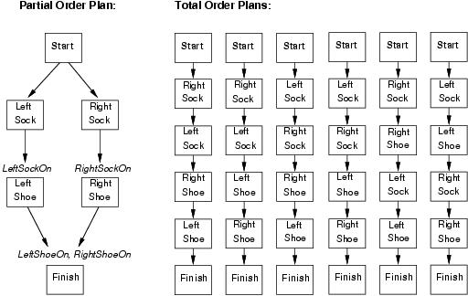
Partial-order planning(POP)
Any planning algorithm that can place two actions into a plan without which comes first is a PO plan.

Slide 54
Components of a Plan
A set of actions
A set of ordering constraints
A p B reads “A before B” but not necessarily immediately before B
Alert: caution to cycles A p B and B p A
A set of causal links (protection intervals) between actions
A B reads “A achieves p for B” and p must remain true from the time A is applied to the time B is applied
Example “RightSock RightShoe
A set of open preconditions
Planners work to reduce the set of open preconditions to the empty set w/o introducing contradictions
p
RightSockOn

Slide 55
Consistent Plan (POP)
Consistent plan is a plan that has
No cycle in the ordering constraints
No conflicts with the causal links
Solution
Is a consistent plan with no open preconditions
To solve a conflict between a causal link A B and an action C (that clobbers, threatens the causal link), we force C to occur outside the “protection interval” by adding
the constraint C p A (demoting C) or
the constraint B p C (promoting C)
p

Slide 56
Setting up the PoP
Start
Add dummy states
Start
Has no preconditions
Its effects are the literals of the initial state
Finish
Its preconditions are the literals of the goal state
Has no effects
Initial Plan:
Actions: {Start, Finish}
Ordering constraints: {Start p Finish}
Causal links: {}
Open Preconditions: {LeftShoeOn,RightShoeOn}
Literal_{a}, Literal_{b}, …
Literal₁, Literal₂, …
Finish
Start
LeftShoeOn, RightShoeOn
Finish

Slide 57
POP as a Search Problem
The successor function arbitrarily picks one open precondition p on an action B
For every possible consistent action A that achieves p
It generates a successor plan adding the causal link A B and the ordering constraint A p B
If A was not in the plan, it adds Start p A and A p Finish
It resolves all conflicts between
the new causal link and all existing actions
between A and all existing causal links
Then it adds the successor states for combination of resolved conflicts
It repeats until no open precondition exists
p

Slide 58
Process summary
Operators on partial plans
Add link from existing plan to open precondition.
Add a step to fulfill an open condition.
Order one step w.r.t another to remove possible conflicts
Gradually move from incomplete/vague plans to complete/correct plans
Backtrack if an open condition is unachievable or if a conflict is irresolvable.

Slide 59
Example: Flat tire problem
Init(At(Flat, Axle) ∧ At(Spare,trunk))
Goal(At(Spare,Axle))
Action(Remove(Spare,Trunk)
PRECOND: At(Spare,Trunk)
EFFECT: ¬At(Spare,Trunk) ∧ At(Spare,Ground))
Action(Remove(Flat,Axle)
PRECOND: At(Flat,Axle)
EFFECT: ¬At(Flat,Axle) ∧ At(Flat,Ground))
Action(PutOn(Spare,Axle)
PRECOND: At(Spare,Groundp) ∧¬At(Flat,Axle)
EFFECT: At(Spare,Axle) ∧ ¬Ar(Spare,Ground))
Action(LeaveOvernight
PRECOND:
EFFECT: ¬ At(Spare,Ground) ∧ ¬ At(Spare,Axle) ∧ ¬ At(Spare,trunk) ∧ ¬ At(Flat,Ground) ∧ ¬ At(Flat,Axle) )

Slide 60
Example of POP: Flat tire problem
See problem description in Fig 11.7 page 391
Only one open precondition
Only 1 applicable action
Start
At(Spare,Trunk), At(Flat,Axle)
At(Spare,Ground), ¬At(Flat,Axle)
PutOn(Spare,Axle)
Pick up At(Spare,Ground)
Choose only applicable action Remove(Spare,Trunk)
At(Spare,Axle)
Finish

Slide 61
Example of POP: Flat tire problem
Add causal link between Remove(Spare,Trunk) and PutOn(Spare,Axle)
Pick up ¬At(Flat,Axle)
There are 2 applicable actions: LeaveOvernight and Remove(Flat,Axle)
Choose LeaveOvernight
LeaveOvernight has effect ¬At(Spare,Ground), which conflicts with the causal link
We remove the conflict by forcing LeaveOvernight to occur before Remove(Spare,Trunk)
Conflicts with effects of Remove(Spare,Trunk)
The only way to resolve the conflict is to undo LeaveOvernightuse the action Remove(Flat,Axle)

Slide 62
Example of POP: Flat tire problem
This time, we choose Remove(Flat,Axle)
Pick up At(Spare,Trunk) and choose Start to achieve it
Pick up At(Flat,Axle) and choose Start to achieve it.
We now have a complete consistent partially ordered plan

Slide 63
POP Algorithm (1)
Backtrack when fails to resolve a threat or find an operator
Causal links
Recognize when to abandon a doomed plan without wasting time expanding irrelevant part of the plan
allow early pruning of inconsistent combination of actions
When actions include variables, we need to find appropriate substitutions
Typically we try to delay commitments to instantiating a variable until we have no other choice (least commitment)
POP is sound, complete, and systematic (no repetition)

Slide 64
POP Algorithm (2)
Decomposes the problem (advantage)
But does not represent states explicitly: it is hard to design heuristic to estimate distance from goal
Example: Number of open preconditions – those that match the effects of the start node. Not perfect (same problems as before)
A heuristic can be used to choose which plan to refine (which precondition to pick-up):
Choose the most-constrained precondition, the one satisfied by the least number of actions. Like in CSPs!
When no action satisfies a precondition, backtrack!
When only one action satisfies a precondition, pick up the precondiction.

Slide 65
POP – Block Example
P:
-:
+: ON(A,TABLE) ON(B,TABLE) ON(C,A) CLEAR(B) CLEAR(C) HANDEMPTY
P: ON(B,A)
ON(C,B)
-:
+:

Slide 66
P: HOLDING(B)
CLEAR(A)
-: CLEAR(A) HOLDING(B)
+: ON(B,A) CLEAR(B) HANDEMPTY
Open preconditions
The plan is incomplete
Stack(B,A)
P:
-:
+: ON(A,TABLE) ON(B,TABLE) ON(C,A) CLEAR(B) CLEAR(C) HANDEMPTY
P: ON(B,A)
ON(C,B)
-:
+:

Slide 67
P: HOLDING(B)
CLEAR(A)
-: CLEAR(A) HOLDING(B)
+: ON(B,A)
CLEAR(B) HANDEMPTY
Stack(B,A)
P:
-:
+: ON(A,TABLE) ON(B,TABLE) ON(C,A) CLEAR(B) CLEAR(C) HANDEMPTY
Stack(C,B)
P: ON(B,A)
ON(C,B)
-:
+:
P: HOLDING(C)
CLEAR(B)
-: CLEAR(B) HOLDING(C)
+: ON(C,B) CLEAR(C) HANDEMPTY

Slide 68
Stack(B,A)
Nonlinear planning searches a plan space
P:
-:
+: ON(A,TABLE) ON(B,TABLE) ON(C,A) CLEAR(B) CLEAR(C) HANDEMPTY
Stack(C,B)
P: ON(B,A)
ON(C,B)
-:
+:
Pickup(C)

Slide 69
Pickup(B)
Other possible achiever
Stack(B,A)
Achievers
Threat
P:
-:
+: ON(A,TABLE) ON(B,TABLE) ON(C,A) CLEAR(B) CLEAR(C) HANDEMPTY
Stack(C,B)
P: ON(B,A)
ON(C,B)
-:
+:
P: CLEAR(B)
Pickup(C)

Slide 70
Pickup(B)
P: CLEAR(B)
Stack(B,A)
P:
-:
+: ON(A,TABLE) ON(B,TABLE) ON(C,A) CLEAR(B) CLEAR(C) HANDEMPTY
Stack(C,B)
P: ON(B,A)
ON(C,B)
-:
+:
P: CLEAR(B)
Pickup(C)

Slide 71
Pickup(B)
A consistent plan is one in which there is no cycle and no conflict between achievers and threats
A conflict can be eliminated by constraining the ordering among the actions or by adding new actions
Stack(B,A)
P:
-:
+: ON(A,TABLE) ON(B,TABLE) ON(C,A) CLEAR(B) CLEAR(C) HANDEMPTY
Stack(C,B)
P: ON(B,A)
ON(C,B)
-:
+:
Note the similarity with constraint propagation
Pickup(C)

Slide 72
Pickup(B)
P: HANDEMPTY
Stack(B,A)
P:
-:
+: ON(A,TABLE) ON(B,TABLE) ON(C,A) CLEAR(B) CLEAR(C) HANDEMPTY
Stack(C,B)
P: ON(B,A)
ON(C,B)
-:
+:
Pickup(C)

Slide 73
Pickup(B)
P: HANDEMPTY
Stack(B,A)
P:
-:
+: ON(A,TABLE) ON(B,TABLE) ON(C,A) CLEAR(B) CLEAR(C) HANDEMPTY
Stack(C,B)
P: ON(B,A)
ON(C,B)
-:
+:
Pickup(C)
P: HANDEMPTY

Slide 74
~ Most-constrained-variable heuristic in CSP → choose the unachieved precondition that can be satisfied in the fewest
number of ways
→ ON(C,TABLE)
Pickup(B)
P: HANDEMPTY CLEAR(B) ON(B,TABLE)
Stack(B,A)
P: HOLDING(B)
CLEAR(A)
P:
-:
+: ON(A,TABLE) ON(B,TABLE) ON(C,A) CLEAR(B) CLEAR(C) HANDEMPTY
Stack(C,B)
P: ON(B,A)
ON(C,B)
-:
+:
P: HOLDING(C)
CLEAR(B)
Pickup(C)
P: HANDEMPTY CLEAR(C) ON(C,TABLE)

Slide 75
Pickup(B)
Stack(B,A)
P:
-:
+: ON(A,TABLE) ON(B,TABLE) ON(C,A) CLEAR(B) CLEAR(C) HANDEMPTY
Stack(C,B)
P: ON(B,A)
ON(C,B)
-:
+:
Pickup(C)
Putdown(C)

Slide 76
Pickup(B)
Stack(B,A)
P:
-:
+: ON(A,TABLE) ON(B,TABLE) ON(C,A) CLEAR(B) CLEAR(C) HANDEMPTY
Stack(C,B)
P: ON(B,A)
ON(C,B)
-:
+:
Unstack(C,A)
Pickup(C)
Putdown(C)

Slide 77
Pickup(B)
P: HANDEMPTY
Stack(B,A)
P:
-:
+: ON(A,TABLE) ON(B,TABLE) ON(C,A) CLEAR(B) CLEAR(C) HANDEMPTY
Stack(C,B)
P: ON(B,A)
ON(C,B)
-:
+:
Unstack(C,A)
Pickup(C)
Putdown(C)

Slide 78
Pickup(B)
Stack(B,A)
P:
-:
+: ON(A,TABLE) ON(B,TABLE) ON(C,A) CLEAR(B) CLEAR(C) HANDEMPTY
Stack(C,B)
P: ON(B,A)
ON(C,B)
-:
+:
Unstack(C,A)
Pickup(C)
Putdown(C)

Slide 79
Pickup(B)
P: HANDEMPTY CLEAR(B) ON(B,TABLE)
The plan is complete because every
precondition of every step is added by some previous step, and no
intermediate step deletes it
Stack(B,A)
P: HOLDING(B)
CLEAR(A)
P: HANDEMPTY CLEAR(C) ON(C,A)
P:
-:
+: ON(A,TABLE) ON(B,TABLE) ON(C,A) CLEAR(B) CLEAR(C) HANDEMPTY
Stack(C,B)
P: ON(B,A)
ON(C,B)
-:
+:
Unstack(C,A)
P: HOLDING(C)
CLEAR(B)
Pickup(C)
Putdown(C)
P: HANDEMPTY CLEAR(C) ON(C,TABLE)
P: HOLDING(C)

Slide 80
Planning Graph
Is special data structure used for
Deriving better heuristic estimates
Extract a solution to the planning problem: GraphPlan algorithm
Is a sequence ⟨S₀,A₀,S₁,A₁,…,S_{i}⟩ of levels
Alternating state levels & action levels
Levels correspond to time stamps
Starting at initial state
State level is a set of (propositional) literals
All those literals that could be true at that level
Action level is a set of (propositionalized) actions
All those actions whose preconditions appear in the state level (ignoring all negative interactions, etc.)
Propositionalization may yield combinatorial explosition in the presence of a large number of objects

Slide 81
Example of a Planning Graph (1)
Init(Have(Cake))
Goal(Have(Cake)∧Eaten(Cake))
Action(Eat(Cake)
Precond: Have(Cake)
Effect: ¬Have(Cake)∧Eaten(Cake))
Action(Bake(Cake)
Precond: ¬Have(Cake)
Effect: Have(Cake))
Propositions true at the initial state
Persistence Actions (noop)
Action is connected to its preconds & effects

Slide 82
Example of a Planning Graph (2)
At each state level, list all literals that may hold at that level
At each action level, list all noops & all actions whose preconditions may hold at previous levels
If some goal literal does not appear in the final level of the graph, the goal is not achievable
Repeat until plan ‘levels contains all the literal of the goal
Terminate if Si = Si+1
Building the Planning Graph is a polynomial process
Add (binary) mutual exclusion (mutex) links between conflicting actions and between conflicting literals
Mutual exclusion links
S₁ represents multiple states

Slide 83
Mutex Links between Actions
Inconsistent effects: one action negates an effect of another
Eat(Cake) & noop of Have(Cake) disagree on effect Have(Cake)
Interference: An action effect negates the precondition of another
Eat(Cake) negates precondition of the noop of Have(Cake):
Competing needs: A precondition on an action is mutex with the precondition of another
Bake(Cake) & Eat(Cake): compete on Have(Cake) precondition

Slide 84
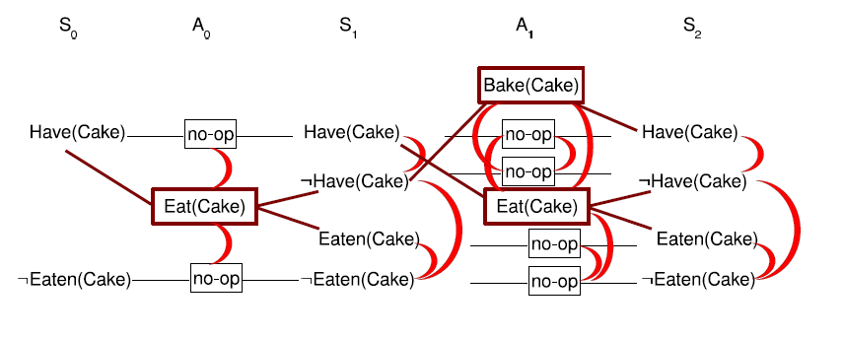
Mutex Links between Literals
Two literals are negation of each other
Inconsistent support: Each pair of actions that can achieve the two literals is mutex. Examples:
In S1, Have(Cake) & Eaten(Cake) are mutex
In S2, they are not because Bake(Cake) & the noop of Eaten(Cake) are not mutex

Slide 85
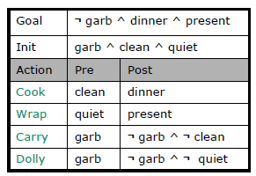
Birthday Dinner Example
Notes:
And there’s a dolly operator, which takes out the garbage using a dolly (a kind of a
hand-cart). It doesn’t make our hands dirty, but it makes a lot of noise. (I
should note that, in the paper, the carry and dolly operators don’t have garbage
as a precondition (I guess you can pretend to take out the garbage if you want
to). We have added it in our example, but it doesn’t really change anything).

Slide 86
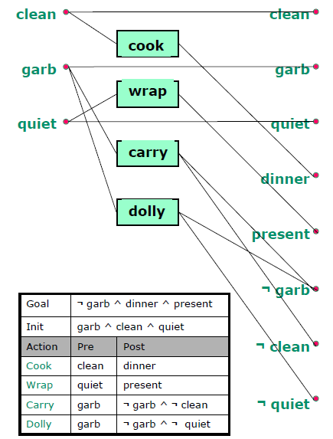
Planning Graph

Slide 87
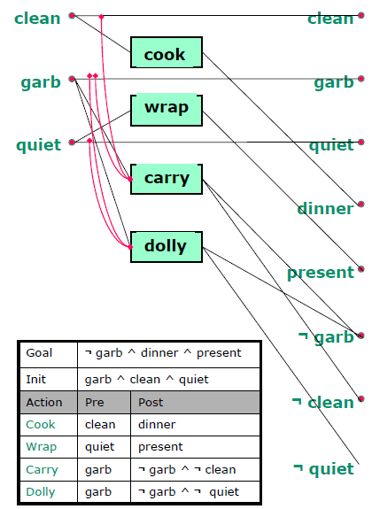
Mutex between Actions
The first reason that actions can be mutex is due to inconsistent effects.
Carry and maintaining clean have inconsistent effects (because carry makes clean false).
Maintaining garb has inconsistent effects with both carry and dolly (which make garb false).
Maintaining quiet has inconsistent effects with dolly (which makes quiet false).

Slide 88
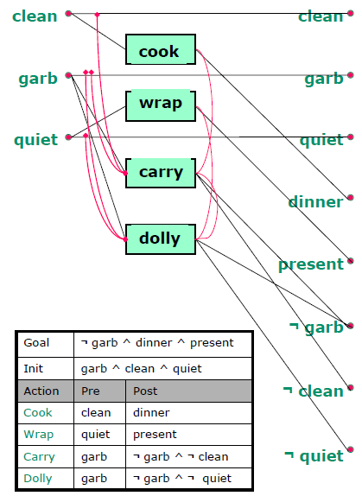
Mutex between Actions
Another kind of mutex is due to interference: one action negates the precondition of another.
We have interference between cook and carry (carry makes clean false, which is required for cook)
also have interference between wrap and dolly (dolly makes quiet false, which is required for wrap.).
we have interference between carry and dolly, because they each require that garbage be present, and they each remove it.

Slide 89
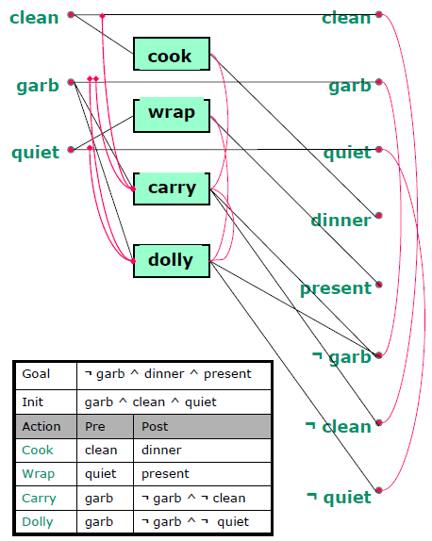
Mutex Links between Literals
First of all, every proposition is mutex with its negation.

Slide 90

Mutex Links between Literals
The other reason we might have mutexes is because of inconsistent support (all ways of achieving the propositions are pairwise mutex).
Here we have that garbage is mutex with not clean and with not quiet (the only way to make garbage true is to maintain it, which is mutex with carry and with dolly).
Dinner is mutex with not clean because cook and carry, the only way of achieving these propositions, are mutex at the previous level.
And present is mutex with not quiet because wrap and dolly are mutex at the previous level
Finally not clean is mutex with not quiet because carry and dolly are mutex at the previous level.

Slide 91
Planning Graph Propery 1
p
¬q
¬r
p
q
¬q
¬r
p
q
¬q
r
¬r
p
q
¬q
r
¬r
A
A
A
B
B
Propositions monotonically increase
(always carried forward by no-ops)

Slide 92
Planning Graph Propery 2
p
¬q
¬r
p
q
¬q
¬r
p
q
¬q
r
¬r
p
q
¬q
r
¬r
A
A
A
B
B
Actions monotonically increase

Slide 93
Planning Graph Properties 3
p
q
r
…
p
q
r
…
p
q
r
…
A
Proposition mutex relationships monotonically decrease
Specifically, if p and q are in layer n and are not mutex then they will not be mutex in future layers.

Slide 94
Planning Graph Propery 4
A
A
A
p
q
…
p
q
r
s
…
p
q
r
s
…
p
q
r
s
…
B
B
B
C
C
C
Action mutex relationships monotonically decrease

Slide 95
Properties 5
Planning Graph ‘levels off’.
After some time k all levels are identical
In terms of propositions, actions, mutexes
This is because there are a finite number of propositions and actions, the set of literals never decreases and mutexes don’t reappear.

Slide 96
Planning Graph Important Ideas
Plan graph construction is polynomial time
Though construction can be expensive when there are many “objects” and hence many propositions
The plan graph captures important properties of the planning problem
Necessarily unreachable literals and actions
Possibly reachable literals and actions
Mutually exclusive literals and actions
Significantly prunes search space compared to previously considered planners
Plan graphs can also be used for deriving admissible (and good non-admissible) heuristics

Slide 97
Planning Graph for Heuristic Estimation
A literal that does not appear in the final level cannot be achieved by any plan
State-space search: Any state containing an unachievable literal has cost h(n)=∝
POP: Any plan with an unachievable open condition has cost h(n)=∝
The cost of achieving any goal literal can be estimated by counting the number of levels before it appears
This heuristic never overestimates
Estimate can be improved by serializing the graph (serial planning graph: one action per level) by adding mutex between all actions in a given level
The estimate of a conjunction of goal literals
Three heuristics: max level, level sum, set level

Slide 98
Estimate of Conjunction of Goal Literals
Max-level
The largest level of a literal in the conjunction
Admissible, not very accurate
Level sum heuristic,
following the subgoal independence assumption, returns the sum of the level costs of the goals; this is inadmissible but works very well in practice for problems that are largely decomposable
Set level
Finds the level at which all literals appear without any pair of them being mutex
Dominates max-level, works extremely well on problems where there is a great deal of interaction among subplans

Slide 99
GraphPlan algorithm
GraphPlan(problem) returns solution or failure
graph ← InitialPlanningGraph(problem)
goals ← Goals[problem]
loop do
if goals all non-mutex in last level of graph then do
solution ← ExtractSolution(graph,goals,Length(graph))
if solution ≠ failure then return solution
else if NoSolutionPossible(graph) then return failure
graph ← ExpandGraph (graph,problem)
Two main stages
Extract solution
Expand the graph

Slide 100
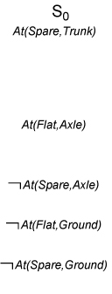
Example of GraphPlan Execution (1)
At(Spare,Axle) is not in S₀
No need to extract solution
Expand the plan

Slide 101
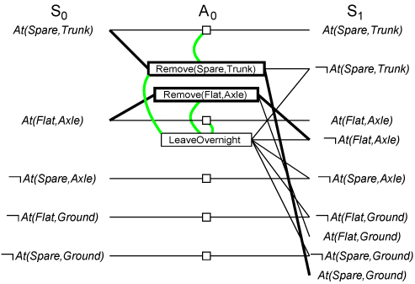
Example of GraphPlan Execution (2)
Three actions are applicable
3 actions and 5 noops are added
Mutex links are added
At(Spare,Axle) still not in S₁
Plan is expanded

Slide 102
Example of GraphPlan Execution (3)
Illustrates well mutex links: inconsistent effects, interference, competing needs, inconsistent support

Slide 103
Solution Extraction (Backward)
Solve a Boolean CSP: Variables are actions, domains are {0=out of plan, 1=in plan), constraints are mutex
Search problem from last level backward

Slide 104
Backtrack Search for Solution Extraction
Starting at the highest fact level
Each goal is put in a goal list for the current fact layer
Search iterates thru each fact in the goal list trying to find an action to support it which is not mutex with any other chosen action
When an action is chosen, its preconditions are added to the goal list of the lower level
When all facts in the goal list of the current level have a consistent assignment of actions, the search moves to the next level
Search backtracks to the previous level when it fails to assign an action to each fact in the goal list at a given level
Search succeeds when the first level is reached.
Notes:
Okay. If all of our subgoals exist at the deepest level (that means, if our goal is P
and not Q, then both P and not Q are in the last proposition level) and they’re
not mutex, we look for a plan. We can describe our search method using
nondeterministic choice via the choose and fail mechanism.
Let I be the deepest level in the graph. For each of our subgoals, we have to pick an
action that can achieve it. So, we start by picking an action at level I – 1 to
achieve P. Then, we pick one of the actions at level I – 1 to achieve not Q. If
they are mutex, then we fail. Failing will cause us to go back and pick a
different way to satisfy P. We search within this level until we find a set of
level I- 1 actions, one for each of our level I subgoals, such that the level I-1
actions are not mutex. If we can’t find such a set, then we fail.
Now, we figure out what the level I-2 preconditions are of the level I-1 actions, and
we make that set of propositions our new set of subgoals. Now we search for a
non mutex set of actions at level I-3 that can make the I-2 subgoals true, and so
on. If we fail at any level, we go back and try to find a different way of
satisfying the preconditions at the previous level.

Slide 105
Example of GraphPlan Execution
For this particular problem, we start at S2 with the goal At(Spare, Axle).
The only choice we have for achieving the goal set is PutOn(Spare, Axle).
That brings us to a search state at S1 with goals At(Spare, Ground) and ¬At(Flat, Axle).
The former can be achieved only by Remove(Spare, Trunk), and the latter by either Remove(Flat, Axle) or LeaveOvernight.
But LeaveOvernight is mutex with Remove(Spare, Trunk), so the only solution is to choose Remove(Spare, Trunk) and Remove(Flat, Axle).
That brings us to a search state at S0 with the goals At(Spare, Trunk) and At(Flat, Axle).
Both of these are present in the state, so we have a solution: the actions Remove(Spare, Trunk) and Remove(Flat, Axle) in level A0, followed by PutOn(Spare, Axle) in A1.

Slide 106
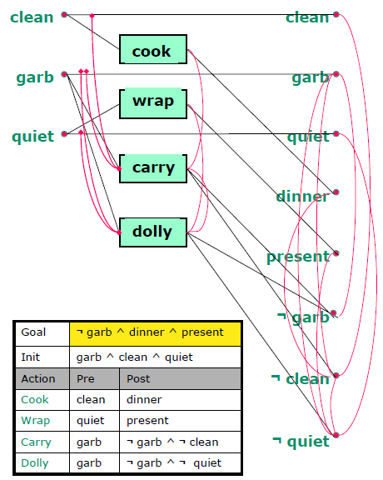
Birthday Dinner Example
Our goal is !garbage and dinner and present.
Layer 2 contains !garbage and dinner and present.
So it looks like these could possibly be true. They're not obviously inconsistent.

Slide 107
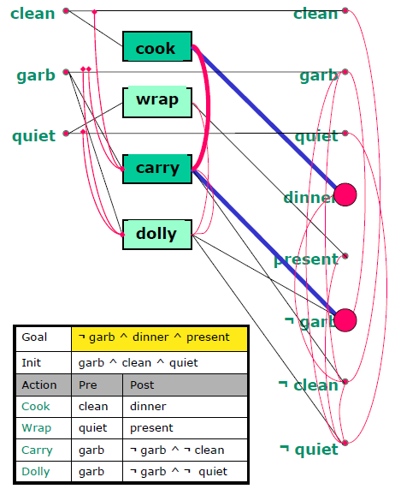
Birthday Dinner Example
So, we’ll start looking for a plan by finding a way to make not garbage true.
We’ll try using the carry action.
Now, we’ll try to make dinner true the only way we can, with the cook action.
But cook and carry are mutex, so this won’t work.

Slide 108
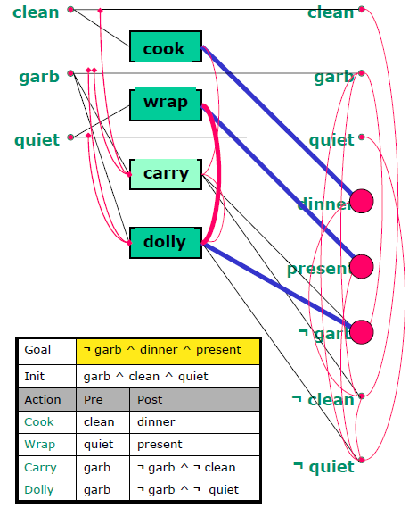
Birthday Dinner Example
Because there aren’t any other ways to make dinner, we fail, and have to try a different way of making not garbage true. This time, we’ll try dolly.
Now, we can cook dinner, and we don’t have any mutex problems with dolly.
We have to make present true as well. The only way of doing that is with wrap, but wrap is mutex with dolly. So, we fail completely.

Slide 109
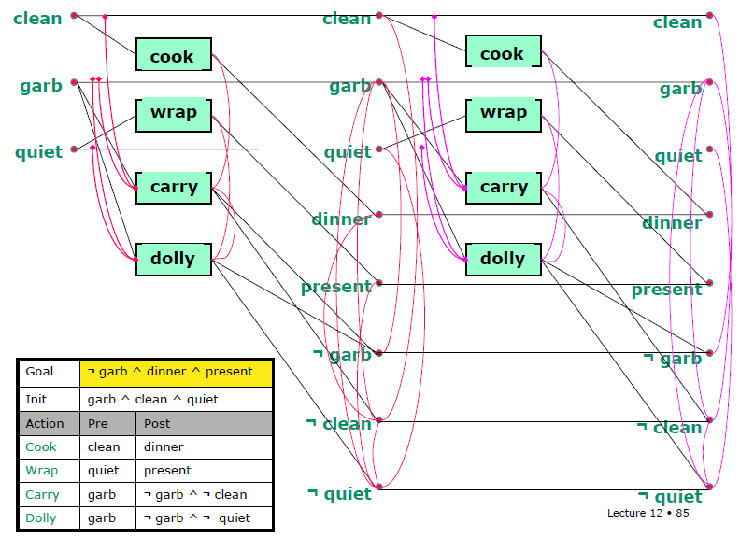
Birthday Dinner Example
There’s no way to achieve all of these goals in parallel. So we have to consider a depth two plan.
We start by adding another layer to the plan graph
Then find and show the Mutexs on the next level

Slide 110
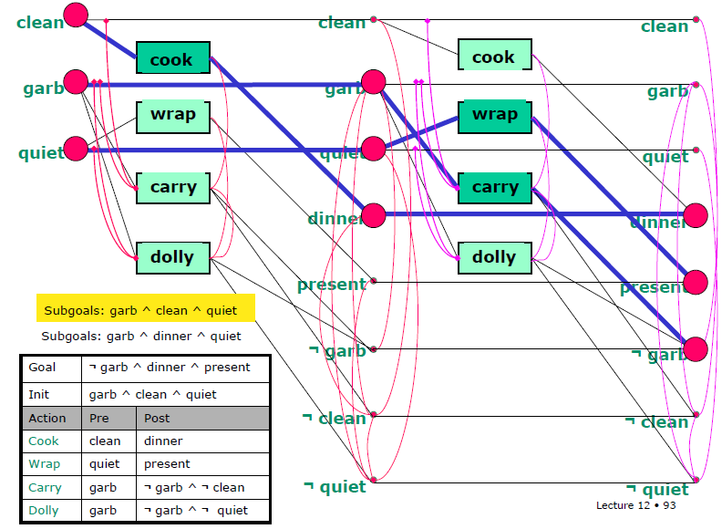
Birthday Dinner Example
Final Solution
Notes:
Now it’s time to try to find a plan again. All of our goal conditions are present in
the last layer, so let’s start searching.
Starting with not garbage, let’s try to satisfy it with carry.
Now we need to satisfy dinner. Since we already know that cook won’t be
compatible with carry at this level, let’s try maintaining dinner from the
previous time step. (Of course, it’s hard to make a computer as clever as we are,
but these are the kinds of tricks that people do when they’re making a planner
really work efficiently).
Last, we need to satisfy present. Let’s try doing it with wrap.
We found a way to satisfy all of our conditions at level 4. So now we have to take
all the preconditions of the actions we picked and see if we can satisfy them at
level 2. Now our subgoals are garbage and dinner and quiet.
Let’s start by satisfying garbage by maintaining it. (We don’t have any way to
make garbage. Though usually when I cook, it makes garbage!).
We can also easily satisfy quiet by maintaining it.
And we can satisfy dinner with the cook action.
Now we have to be sure that we can satisfy all of these preconditions at level 0. Our
subgoals now are garbage, clean, and wrap. They’re all true at level 0, so we’re
done! There were actually a lot of plans that would have worked, but here’s one
of them. If we’re going to do actions in order, this plan will allow us to do cook
then wrap then carry, or cook then carry, then wrap. The crucial thing is that it
forces us to do cook before carry, which we couldn’t enforce in a depth 1 plan.

Slide 111
Improving search using Heuristic
The search may still degenerate to an exponential exploration
Heuristic:
1. Pick the literal with a highest level cost
2. To achieve this literal, pick actions with easiest preconditions (the set of preconditions which has the smallest max level cost)

Slide 112
Termination of GraphPlan
GraphPlan is guaranteed to terminate
Literal increase monotonically
Actions increase monotonically
Mutexes decrease monotinically
A solution is guaranteed not to exist when
The graph levels off with all goals present & non-mutex, and
ExtractSolution fails to find solution

Slide 113
Optimality of GraphPlan
The plans generated by GraphPlan
Are optimal in the number of steps needed to execute the plan
Not necessarily optimal in the number of actions in the plan (GraphPlan produces partially ordered plans)

